Slide 1
Design and Analysis of Algorithms (CS-302)
Muhammad Waqas Sheikh
Waqas.sheikh@nu.edu.pk

Slide 2

Course Objectives
Design algorithms using different algorithms design techniques i.e. Brute Force, Divide and Conquer, Dynamic Programming, Greedy Algorithms
Analyse the time and space complexity of different algorithms by using standard analysis techniques for recursive and non-recursive algorithms.
Discussion on Asymptotic notations, standard complexity classes and representation of time complexities in asymptotic notations of standard complexity functions

Slide 3
Course Objectives
Describe, compare, analyse, and solve general algorithmic problem types: Sorting, Searching, String Processing, Graph.
Implement the algorithms, compare the implementations empirically, and apply fundamental algorithms knowledge to solve real-world problems.
Understanding of NP-Completeness and Approximate Problems.

Slide 4
Topics to be Covered
List of Topics | No. of Weeks
Basics of Algorithms, Mathematical Foundation, Growth of Function, Asymptotic Notations. | 2
Divide and Conquer, Substitution Method, Recurrence-Tree Method, Master’s Method. | 2
Sorting (Merge, Insertion, Quick, Heap, Counting, Radix), Data Structures (Stack, Queue, Linked List, Hash Table, Binary Tree). | 1
Dynamic Programming | 1.5
Greedy Algorithms, Graph Theory (Graph Categorization, Graph Terminology, Representation of Graphs, BFS & DFS, Strongly Connected Components, Greedy Algorithms: Kruskal’s Algorithm, Prim’s Algorithms, Bellman-Ford Algorithms, Dijkstra’s Algorithm) | 3
Geometric Algorithms (Introduction, Graham Scan, Close Points). String Matching | 2
NP Complete Problems and Solutions using Approximation Algorithm | 2
Review | 0.5
Project Presentations | 1

Slide 5
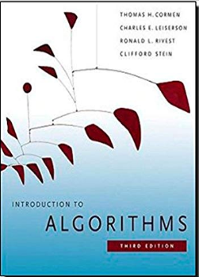
Course Contents and Text Book
Text Book
Thomas H. Cormen et al. “Introduction to Algorithms” 3rd Edition.
Textbook

Slide 6
Reference Books and Evaluation Criteria
Reference Books
Anany Levitin “Introduction to the design and analysis of algorithms” 3rd Edition.
Evaluation Criteria
Midterm I: 12.5 Marks
Midterm II: 12.5 Marks
Quiz/Assignment: 15 Marks
Project: 10 Marks
Final: 50 Marks

Slide 7
Advanced Operating Systems
Mode of communication
Lectures shall be uploaded on SLATE every week
My email: Waqas.sheikh@nu.edu.pk
Contact Hours
Consultancy hours As and when required
Course Pre-requisites
Data Structures
Graphs

